Slide 1
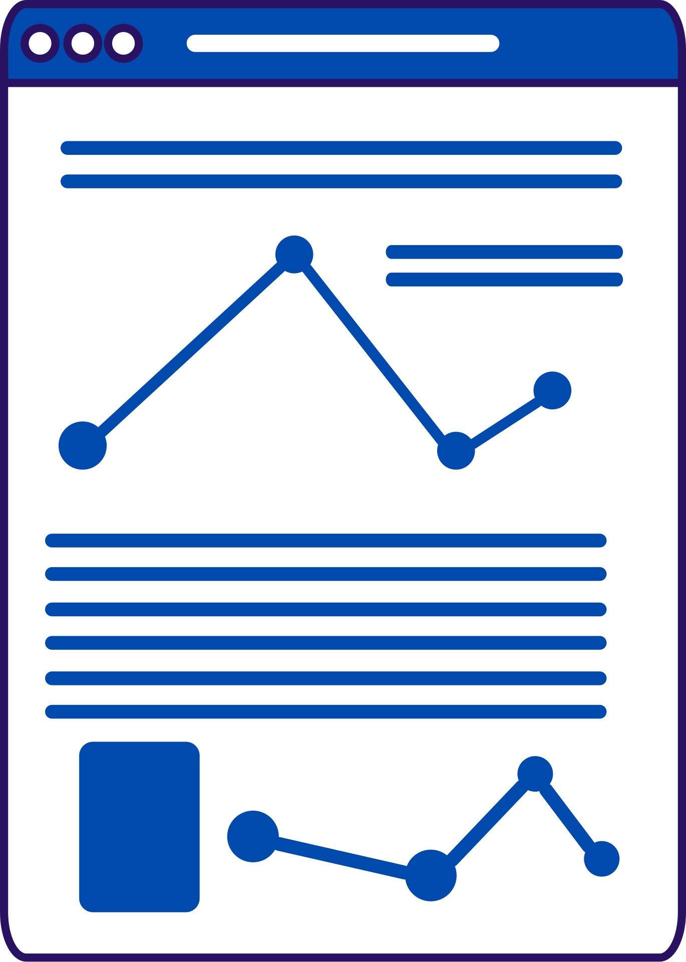
Introduction to Generative AI and Python Basics

Slide 2


List Of Contents
Introduction to AI and Gen AI
How AI is replacing human tasks?
Real Life Applications of AI
Introduction to Python
Why Python for AI?
Basics of Python
Variables and Data types
Control flow (if-else and loops)
4
7. Dicussion,Conclusion and Refrences

Slide 3
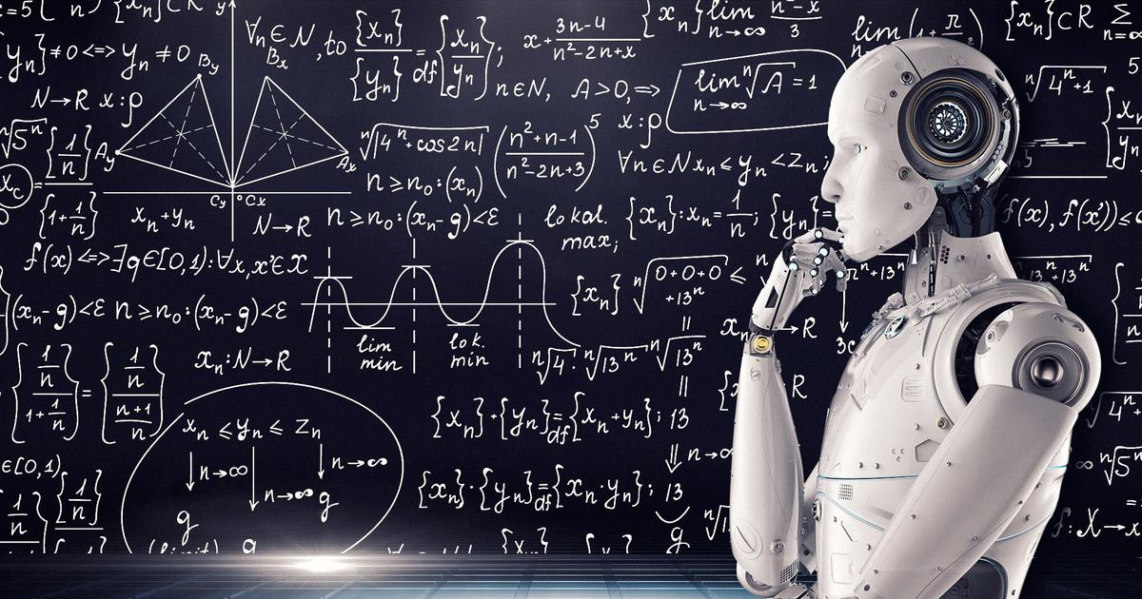

Slide 4
What is AI?
Artificial Intelligence (AI) refers to the linking human intelligence in machines so that they can think, learn, and perform tasks that typically requiring human intelligence. It mainly focuses on analyzing data and making predictions.
What is Gen AI?
Generative AI refers to a branch of artificial intelligence focused on creating new content, such as text, images, audio, video, and more, by learning patterns from existing data.

Slide 5
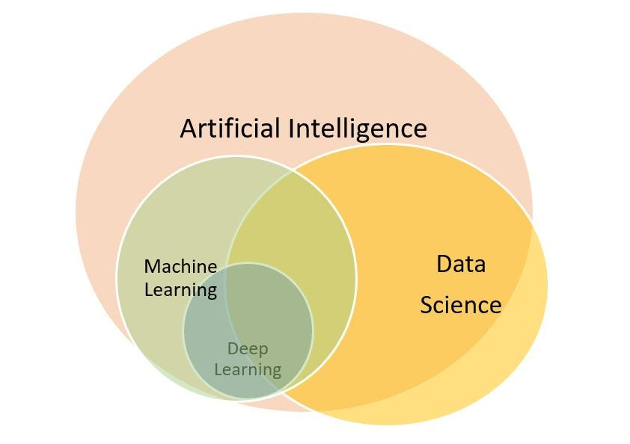
AI, Data Science, ML:

Slide 6
Applications of Gen AI
1. ChatGPT (Text Generation)
Chatbots, writing assistants, and customer service.
2. DALL-E (Image Generation)
Creating art, product design, and visual content.
3. Deepfake Generation (Video and Audio Synthesis):
Deepfake Generation (Video and Audio Synthesis):

Slide 7
Real world Applications of AI
Healthcare
01
Symptom Analysis, Disease Prediction
Crop Yield Predictions, Weather Predictions
03
02
Education
Student Performance prediction, recommending study plans
04
SMS and email spam detection

Slide 8





WHY PYTHON?
Syntax is clear and easy to understand.
Beginner Friendly
Extensive in-built libraries for ML and AI
Various Purpose Programming
Matplotlib, numpy, scikit learn, seaborn

Slide 9
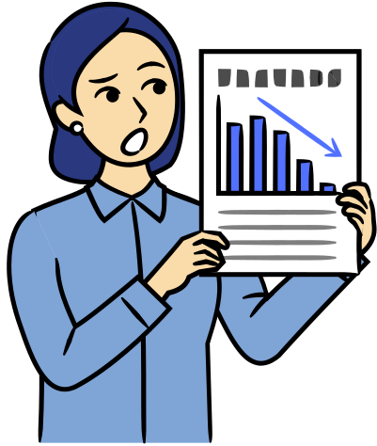
Starting Python Basics
Print Statements
writing simple python scripts
3. Variables
Variables are containers to hold or save data. Data is accessed through variables

Slide 10
Types of Variables
Intergars (int) : Whole numbers
Float (float) : Real number with decimal point
String (str) : texts
Boolean (bool): True or False (1 or 0)

Slide 11
Types of Variables
Type casting
Converting integar to string and vice versa according to the requirement
Updating the value of variable
Formatted string
Print(f”string part {variable name}”)

Slide 12
Control flow in Python
If-else statements
While loop
For loop
break, continue
and, or

Slide 13
If- else
If (condition 1 is true):
statement no 1
statement no2
so on
Else:
statement 1
statement 2
so on
INDENTATION IS VERY IMPORTANT

Slide 14
Conditional operators
Use of operators:
> Greater than
< less than
<= less than or equal to
>= greater than or equal to
== equal to
!= not equal to

Slide 15
Data validation using nested if.
Example: Entering a valid number

Slide 16
If- elif- else
If (condition 1 is true):
multiple statements
Elif(condition 2):
multiple statements
Elif (condition 3):
multiple statements
Else(if no above condition is true):
statement

Slide 17
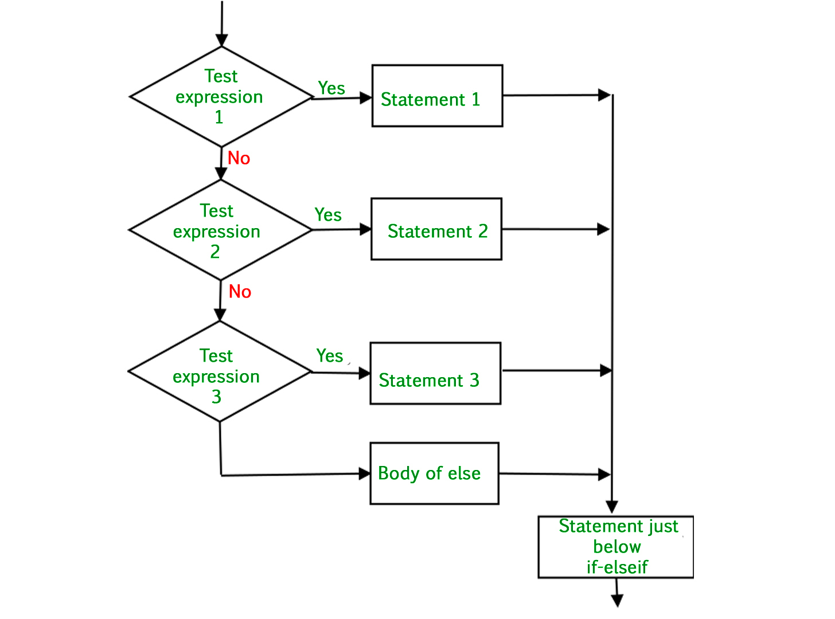

Slide 18
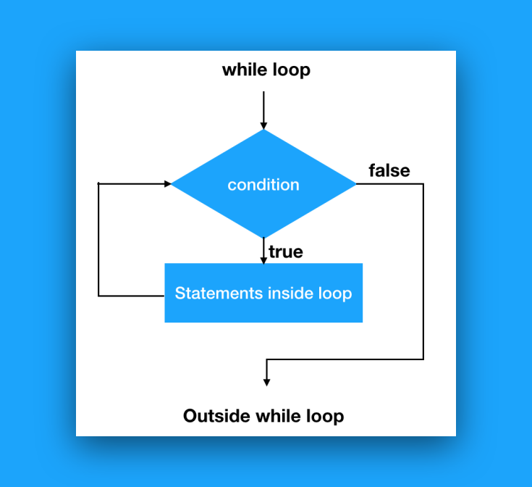

Slide 19
Practice of basic concepts
Write a program that input 10 numbers from user and print their sum.
Write a program that input 5 numbers from user and print the largest

Slide 20
Mini project for hands-on practice
Calculator Program using loops and if-else
Traffic control (R, G, Y)

